Slide 1
Some sources of Weather Data Before Prep signal (i.e. for fee) RRS41 & Case 120 Legal During Racing
SailFlow pro WF WRF (.02) SailFlow pro HRRR (.027), hourly update SailFlow pro Observations Anita, TI (L6), Blunt, Aquatic Park (1), Berkeley Marina, Royce Beach Toll PWE (.01), 12 hour update (0000 and 1200 PDT) PWG (.01), 12 hour update (0945 and 2145 PDT) SailFlow pro current model Tidetech current model (.001), check timing to NOAA Satellite imagery IR is best for convection Looped images from geo satellites, not APT Adrena provides terrific overlay on grib data. Sailtactics.com, wind and current, Mike Dvorak | HRRR from Saildocs (.027) Updated ~ 35 min after each hour SailFlow Observations via free account GGB, CG pier, Pier 1?, Oakland, Marina District?, TI (10th st)?. (? = sketchy data) NOAA Ready site HRRR chart (.027), 850mb/10m temps, CAPE, LFTX, Skew-T hourly updates Weather radar (lots of free sites)

Slide 2
Vertical Stability, seabreeze potential, squalls/thunderstorm potential offshore.
CAPE (convective available potential energy) (>1000 gets interesting)
LFTX (lifting index) (< -2 gets interesting)
Surface temp-850mb temp (> 7 deg C gets interesting)
Skew-T plots
Satellite imagery esp IR (terrific offshore to detect squalls, when legal)
Mesoscale models (HRRR is stunning, US only, free, legal anytime via Saildocs or NOAA Ready, hourly updates, essential)
Watch vertical stability in Lodi (38.25 -121.25 decimal deg)

Slide 3
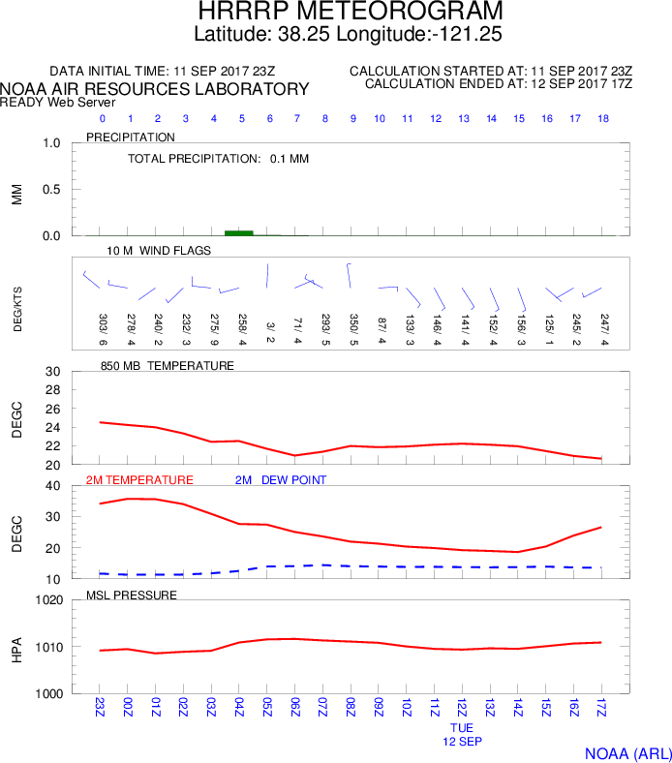

Slide 4
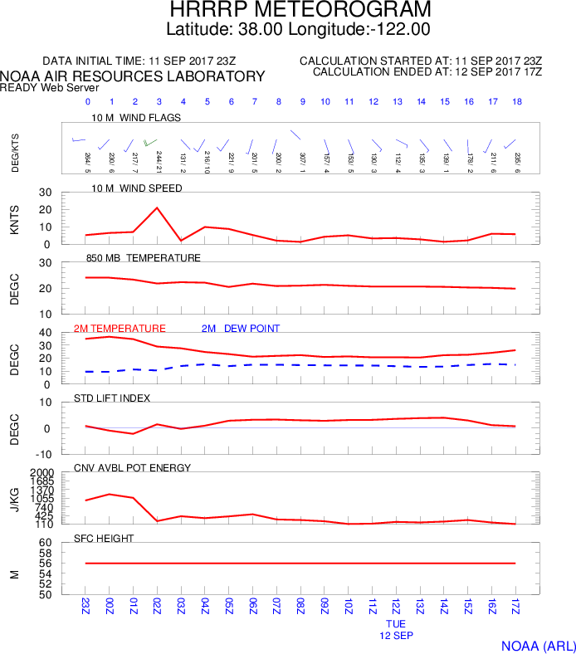

Slide 5
NEVER trust “rules of thumb”. Race in the wind and current that you’ve got. Some example Rules of Thumb:
Overall Observations:
Ebb starts on Blunt at same time as on City Front (i.e. at Max Flood), W of Blunt can be dangerous.
In S wind play N, In N Wind play S
Take notes on current charts, keep them forever.
Beats
Blunt is ok early in Ebb, except if big flood then nfg
From TI to cone, go close to TI, tack when past W corner
Cone works until 1 hour after max flood, if L wind, lay along face, if R wind or traffic jam head to Aquatic before the face.
Use City Front after max flood, go wider as ebb spreads, go wider in traffic to reduce ducks
Mid ebb, when wide current, nice shift going into rounded part of City Front
N of Alcatraz works so long as there is still ebb there, until 2 hours before max flood.
Circle: go left in morning (esp in flood). When the vertical wind twist stops then go right. (Useful trick in lots of places.)
Reaches
Harding to Blossom, only go to leeward of Alcatraz if you can’t fetch.
Runs
In ebb, close to Alcatraz, leave to stbd, then jibe
Good lanes of wind down beach, but watch hole DW of Club

Slide 6
URL’s and Email requests:
Send an email to: “query@saildocs.com” The subject line doesn’t matter, include one of the following lines. Send one per email to keep it simple but multiple lines are accepted. Will get response within seconds. Free and legal while racing.
send gribmodels
This provides a list of models and parameters
send gribinfo
This provides background information on grib retrieval from saildocs
send HRRR:39N,37N,123W,121W|0.02,0.02|0,1..24|WIND,LFTX,CAPE,RAIN
This provides an HRRR grib file for SF Bay and Central Valley, available hourly at 40 minutes after every hour. H0 time will be 1h40m prior. Forecasts hourly through H18. Free and legal under RRS41 and Case 120. Grib file viewable by Expedition, Adrena, DfW, Macsea, Viewfax (free), and lots of other programs.
sub HRRR:39N,37N,123W,121W|0.02,0.02|0,1..24|WIND,LFTX,CAPE,RAIN Days=3 interval=1 time=00:40
This will cause you to receive an hourly grib file from HRRR, forty minutes after every hour, for three days. Cancellable any time by reading the footer on the email.
NOAA Ready site: https://www.ready.noaa.gov/READYcmet.php
Source of HRRR forecast wind charts, Skew-T soundings, 850mb/10m temps, HRRR spot forecasts, CAPE, LFTX
User interface takes some practice. Hostile for sailors, familiar for meteorologists. Fast, free, legal, with hourly updates.

Slide 7
All of this stuff is posted at:
Honeynav.com Under the “articles” category, as: “SF Bay Weather Tips” article.

