Slide 1
Navigator Preparation for an Ocean Race
Stan Honey

Slide 2
Preparation Assumptions and Background
Navigator responsible to avoid many of the big blunders
Starting early
Starting late
Missing a mark
Running aground
Misinterpreting SI’s or NOR
Not having required equipment, OSR’s or otherwise
Procedural error with respect to protests
Measurement certificate valid and consistent with yacht
Electronic safety gear
Electronics
Check-in’s, start, rollcall, pre-finish, post-finish
Filing required forms, RC, Immigration, Customs, etc.
Have to memorize information:
SI’s, NOR, Hazards, weather forecast, plan.

Slide 3
Exotic Professional Long Term Preparation
Retrieve 11 years of weather for the 11 days surrounding the calendar date of the start. Typically GFS OH files.
Run 121 routes (11x11) for your boat and for each configuration being considered.
Typically use ORR vpp’s or designer vpp’s, but same source for each configuration. ORR vpp’s are very good for this.
Analyze results
% wind angles, % wind speeds
Compare different boat configurations to see % of races each boat wins
For your race boat, calculate and plot all tracks on a single “highway” plot, important, study, inspect and understand outliers.
Tinker. Interesting questions emerge.
Develop polars for boat using logged data during races, if the logged data exists and if the configuration is relevant.
“Nav” polars must be achievable, including sail changes, average helmsmen, etc.
Volvo example. Polars for competitors for VOR.
Performance Polars only change with a crew meeting.
Navigate notable previous tracks in their weather with their polars and compare to actual track and decisions. Drag the skipper through the most expensive decisions.

Slide 4
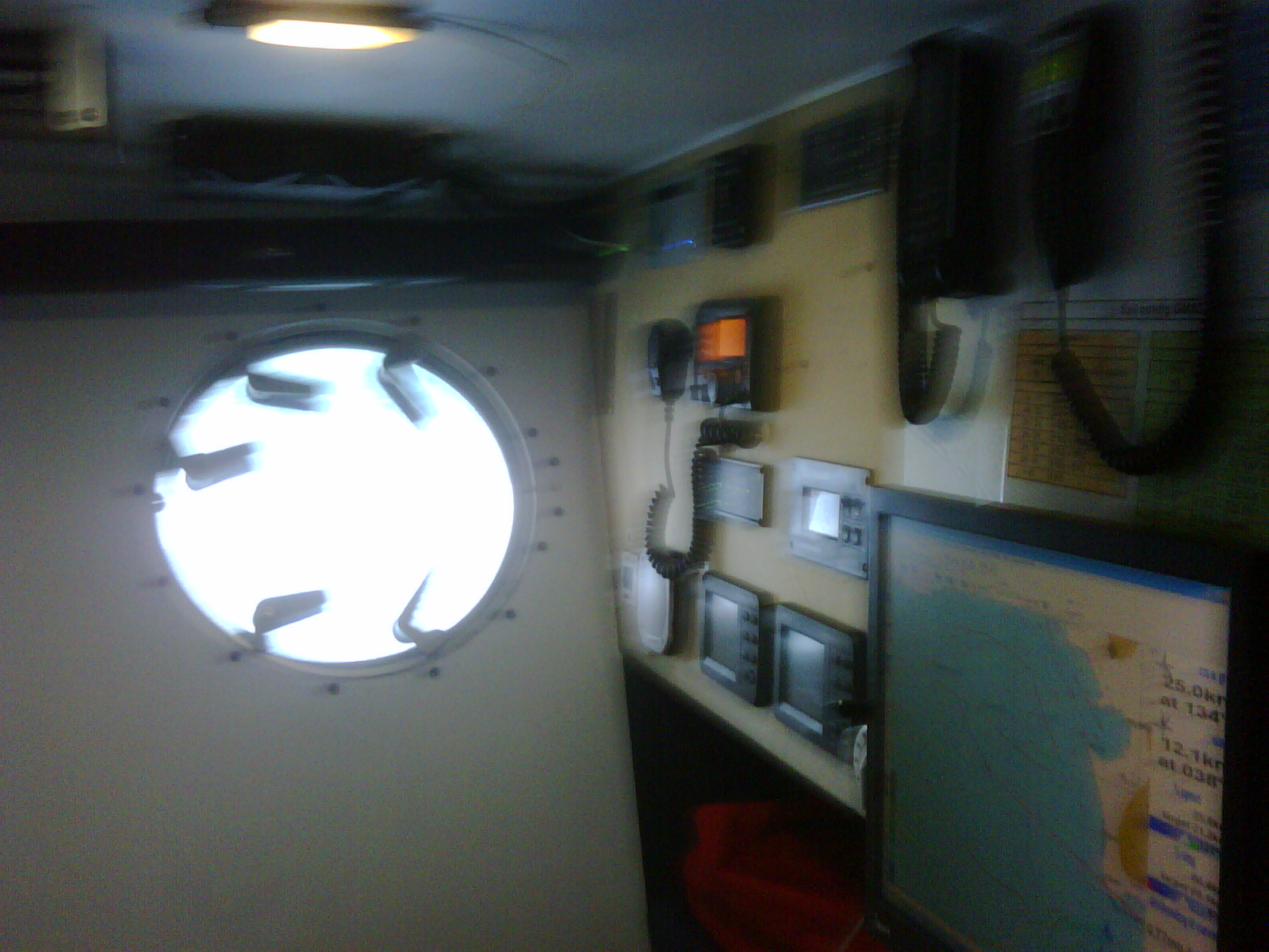

Slide 5
Pre-race preparation at home. Basic items.
Paper charts for: start, finish, overall course, and other important corners. Highlight them with hazards, notes, conventional tracks, marks, bearings.
Typically 10-12
Keep the small scale chart with notes.
Memorize hazards on chart.
Electronic charts.
Polars for boat, ORR and designer versions. “Nav” polars must be achievable on average. Not “targets”.
Laminate target table, multiple copies
Laminate sail chart, multiple copies
Laminate SI’s, NOR’s, chart fragments.
Laminate navigator’s daily schedule, weather downloads, rollcalls, watch changes, fleet analysis, etc.
Documentation and configuration information for important electronics, and instrumentation on memory stick.
Select weather consultant(s) and start discussions. Don’t ask met guys about routing.
Read accounts of previous races but don’t dwell on racing in a previous race.
Talk to experienced navigators, ideally in person. What are key decisions and when? They will answer, so must you.

Slide 6
Boatspeed with colours
VPP | 40 | 45 | 50 | 55 | 60 | 65 | 70 | 75 | 80 | 85 | 90 | 95 | 100 | 105 | 110 | 115 | 120 | 125 | 130 | 135 | 140 | 145 | 150
32 | R | R | R | R | R | R | 2R | 2R | 2R | 2R | 2R | 2R | 2R | 2R | 2R | 2R | 2R | R | R | R | R | R | R
31 | R | R | R | R | R | R | 2R | 2R | 2R | 2R | 2R | 2R | 2R | 2R | 2R | 2R | 2R | R | R | R | R | R | R
30 | R | R | R | R | R | R | R | R | R | R | 2R | 2R | 2R | 2R | 2R | 2R | 2R | R | R | R | R | R | R
29 | R | R | R | R | R | R | R | R | R | R | R | R | 2R | R | R | R | R | R | R | R | R | R | R
28 |  |  |  |  |  |  |  |  |  |  | R | R | R | R | R | R | R | R | R | R | R | R | R
27 |  |  |  |  |  |  |  |  |  |  |  | R | R | R | R | R | R | R | R | R | R | R | R
26 |  |  |  |  |  |  |  |  |  |  |  |  | R | R |  | R | R | R | R | R | R | R | R
25 |  |  |  |  |  |  |  |  |  |  |  |  | R | R |  | R | R | R | R | R | R | R | R
24 |  |  |  |  |  |  |  |  |  |  |  |  |  |  |  | R | R | R | R | R |  | R
23 |  |  |  |  |  |  |  |  |  |  |  |  |  |  |  | R | R | R | R | R |  | R
22 |  |  |  |  |  |  |  |  |  |  |  |  |  |  |  |  | R | R | R | R
21 |  |  |  |  |  |  |  |  |  |  |  |  |  |  |  | R | R | R | R | R
20 |  |  |  |  |  |  |  |  |  |  |  |  |  |  |  | R | R | R | R | R
19 |  |  |  |  |  |  |  |  |  |  |  |  |  |  |  | R | R | R
18
17
16
15
14
13
12
11
10
9
8
7
6
5
4
 | J2 | J4 | R1 | R2 | R3 | A0 | A3 | A4 | A6
Vs>18kts
Aft Tank
Vs>17.5kts
Vs>15kts
Full Daggerboard
Full DB AWA<45
No DB AWA>50

Slide 7
TWS | BS UW | TWA UW | BS DW | TWA DW
4 | 5.4 | 46 | 5.8 | 136
5 | 6.4 | 44 | 6.7 | 137
6 | 7.3 | 43 | 7.7 | 138
7 | 8.1 | 43 | 8.6 | 138
8 | 8.9 | 42 | 9.5 | 139
9 | 9.4 | 42 | 10.0 | 140
10 | 9.9 | 41 | 10.5 | 142
11 | 10.4 | 41 | 11.4 | 142
12 | 10.8 | 40 | 12.3 | 143
13 | 10.9 | 40 | 13.2 | 143
14 | 11.0 | 39 | 14.0 | 143
16 | 11.7 | 39 | 16.3 | 143
18 | 12.0 | 38 | 17.7 | 144
20 | 12.4 | 38 | 19.1 | 145
22 | 12.7 | 39 | 20.7 | 146
24 | 13.0 | 39 | 22.2 | 147
26 | 13.2 | 39 | 23.7 | 148
28 | 13.8 | 40 | 25.2 | 149
30 | 13.8 | 41 | 26.9 | 150
32 | 14.0 | 42 | 30.3 | 152

Slide 8
The Navigator’s Kit
Light spectra cord
Self-adhesive velcro
Usb memory sticks
Submersible headlamp and spare batteries (red option preferred)
Mini DVM
Rigging tape
Multi-miniature screwdriver tool
Multi-tool, e.g. Leatherman
Small wire ties
Small magnifying glass
Zip lock bags
Handheld gps with USB cable
handbearing compass
Light plastic micrometer drum sextant for Transoceanic races
Roll of paper towels
Backpacking towel (synthetic)
Sharpies
pencils
Printed SI’s and NOR etc
Wetnote notebook
RRS
OSR’s
Protest forms
Yellow and Red flags
Calculator
Boat Kit
Binoculars with compass
HH VHF with speakermic
Dividers and triangles
Gray plastic sextant for transoceanic
Sparky kit
Backup CD’s sw, charts
Mirrored HD
Yellow, Red flags

Slide 10
The week before the start
Memorize the SI’s, course, starting order, flags, check-in ritual, etc. Notes ok but MUST memorize.
Memorize times for weather downloads
Memorize hazards.
Update the computer and all programs right away.
Check:
current signed rating certificate is onboard
Boat’s document and registration is onboard
Run virus scan and make sure scanner is installed and enabled.
Firewall PC from satellite
Mirror HD update
Completely go through chart table and navigation gear, get delivery junk off boat.
Assemble small duffle bag for chart table detritus (wallets, cellphones, car keys, papers, winch pawl springs, etc)
Assemble Navigator’s ditch bag, GPS, handheld VHF, Iridium antenna and spare battery, passports for entire crew, flashlight, SAR phone number written on back of Iridium.

Slide 12
Week before the Start
Calibrate instruments, order is important
knotmeter
AWA
AWS
Swing electronic compass and test
Only now do computed wind, ideally in a blustery NW wind, well mixed vertically.
TWA corrections uw, reaching, and dw so that TWD stays constant with tacks and gybes, including reach to reach
TWS corrections at WL mark roundings so TWS stays same once squared away on running angles
Multiple correction tables necessary for masthead tight-luff vs flying asails and zero’s.
Repeat, repeat, repeat, don’t panic as wind-weight, twist-aloft, and shear-aloft continues to change, particularly in thermal breezes.
Calibrate barograph.

Slide 14
More in the week before the start
Swing conventional compasses
Remove corrector magnets unless it’s a steel boat
Use the distant landmark method, rotating boat to 8 cardinal and intercardinal headings.
Plot compass bearings of landmark versus heading.
Do DFT terms 2 and 3 (1 cycle and 2 cycle, by eye is ok)
Finally, work out compass rotation (DFT “DC” term)
Write up compass deviation card.
Check that basic electronics installations are complete
DSC VHF has mmsi number entered and GPS interface works
AIS is configured with mmsi number and interfaced to chartplotter or radar
EPIRB is registered properly

Slide 15
Still more in the week before the start
Iridium/Inmarsat/SailMail account is active, gear is interfaced, and grib files can be downloaded. GFS and Coamps at a minimum as they are legal during the race. (other stuff prior to the prep)
In addition to other weather research with shore based internet and high resolution data, do daily grib downloads of 0,6,12,18z runs and compute routes off of them. Good test and good practice.
Subscribe to email grib server (www.saildocs.com is one of many)
Test and trial a fleet analysis tool, either with previous race’s data or with data from earlier starts if race has staggered starts, or both.
Periodic briefing with a weather expert and with the skipper and watch captains.
DO NOT Prejudge and make a plan prior to the night before the start.
DO discuss a TENTATIVE plan the night before the start.
DO have a plan early the morning of the start, memorize it.
Review SI/s and NOR with skipper, tactician, watch captains, bowman.
If using start tool, practice with helmsman, tactician, and bowman, and work out terminology (time to burn, time-to-line/start, BL to line). Calibrate turn rate vs speed and time-to-speed.
Squall chalk talk with crew.

Slide 17
In the week before the start, if you are the onboard sparky.
Run the batteries and charge system through a cycle.
Completely understand the electrical system and draw an overall schematic if there isn’t one (pretty good bet).
Test all electronics right away to provide time to deal with problems.
Test all lights, running lights, compass lights, trim lights etc.
Test spare running lights
Check and inventory all spares and tools (next slide).

Slide 18
Spares if you’re the sparky
tools,
crimps,
spare wire,
Fuses (including on-engine ones)
bulbs,
spare compass lights,
spare running lights,
spare regulator, ideally identical to current one.
butane soldering iron,
Leave hot knife blade on soldering iron and keep soldering tip separate.
solder,
Entire spare masthead wand plus
BG213 board,
spare cups
spare vane,
mirrored HD for PC,
spare paddles,
WD40
heat shrink tubing,
Silicone dielectric grease,
wire ties
Crossover cable
Usb to serial adapter
Serial extension cable
Extra wire-ties, tape, and heat-shrink to allow for borrowing

Slide 19
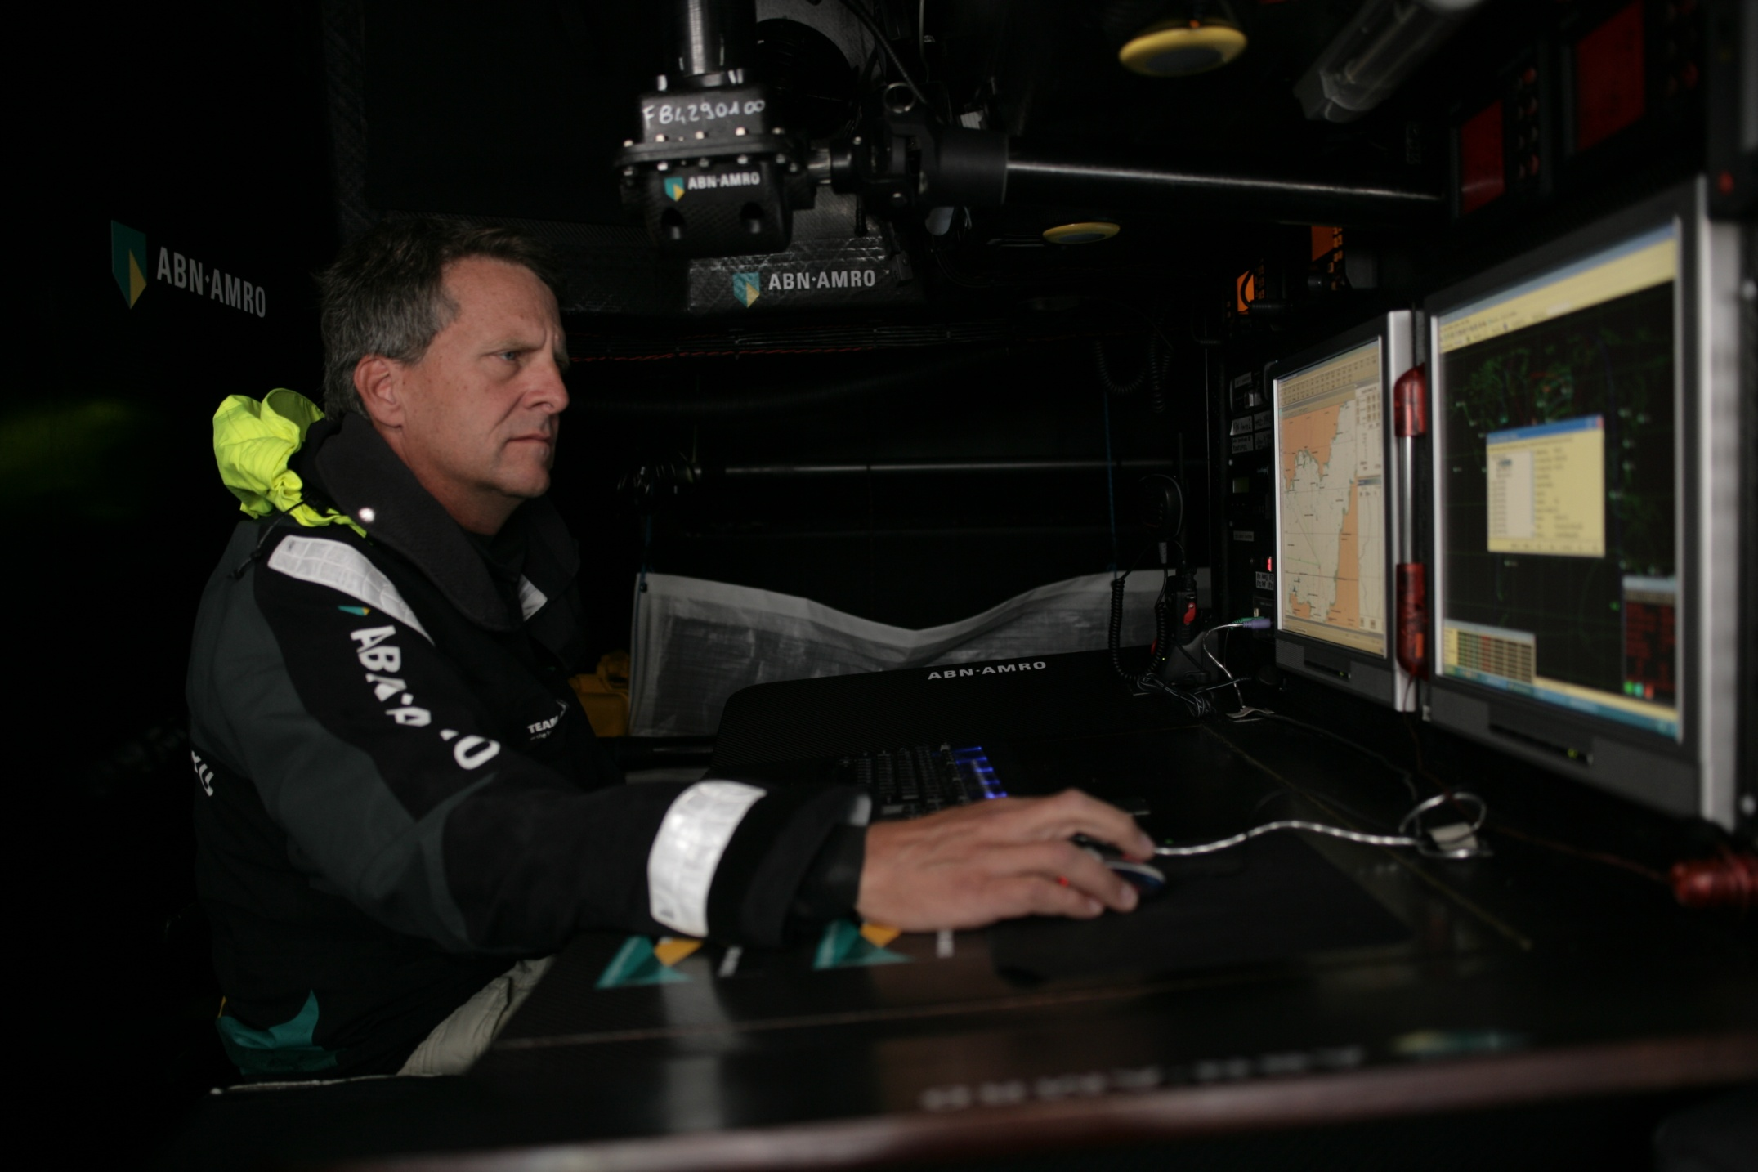

Slide 20
Morning of the Start
Have a plan and memorize the headings and tack/gybe headings.
All crew briefing, off the dock, using small scale chart.
Overall course
Overall weather
Initial plan
Hazards in vicinity of start.
Penalty rituals, special rules.
Start rituals, check-in, start restrictions, life-jacket requirements, flags, etc…
Have a checklist of gear to bring and things to do on final morning.
chart dongle
memory stick
charged handheld radio with speakermic
Personal gear that isn’t already onboard (passport, sunnies, etc)
Sync watch to GPS or WWV,
Sync bowman’s watch
Final weather check.
Stay off the bricks, don’t miss the marks.

Slide 21
Periodic ritual offshore
Stay off the bricks, don’t miss the marks.
Download weather models and weather maps.
Inspect weather maps and do eyeball routing.
Inspect models in grib viewer and do eyeball routing.
Run initial routes.
Inspect reverse isochrones superimposed on forward isochrones to identify “don’t-care areas”
Formulate key questions
What is important?
What goes wrong if weather is wrong in different ways (faster, slower, more turbulent, light at front…)?
Tinker with routing, asking questions, more wind, start later, start sooner, stop somewhere, slower polars (seastate), force waypoints, force GC
Develop “risk assessments” and “ cost of insurance”
Run routes for key competitors
with your polars to understand weather and routing differences
With their polars to see what they see
Develop “risk assessments” and “insurance expenses” for different decisions by competitors and covering strategies.
Brief skipper on findings.
Detailed Written Log Entry summarizing weather, strategy, and tactics
Plot track and competitors on paper overall course chart, post
Print out weather map and 12 hour forecast and with your sailing directions
Meet with watch captains.
Brief watch
detailed 12 hour forecast
sailor’s description of the plan
Competitors locations and tactics
What to watch for
Snack, nap, and repeat in an hour.

Slide 22
Navigation Career Tips:
Keep your day job.
Prepare, prepare, prepare.
Be rock-solid on the basics
Marks, rocks, SI’s, electronics, etc.
Check as many “boxes” as you can:
Electronics, IT, electrical
Diesel mechanics
Hydraulics
Medical
(boatbuilding, rigging, sailmaking, provisioning, media)
Don’t assume that the right answer is complicated or subtle

Slide 23
Finally, my father’s advice for all offshore sailors:
Keep your head warm
Keep your feet dry
Keep your eyes open
Keep your mouth shut

